Slide 1


FACIAL EMOTION RECOGNITION USING DEEP LEARNING
M JAYESH - CB.SC.U4AIE24128
M RAKESH - CB.SC.U4AIE24134
CH VIRINCHI SAI - CB.SC.U4AIE24158
K JATIN CHANDRA GUPTA - CB.SC.U4AIE24162

Slide 2

INTRODUCTION
Facial Emotion Recognition (FER) using deep learning is a computer vision technique that helps identify human emotions based on facial expressions. It works by training a deep learning model on datasets that contain labeled images of faces, each associated with a specific emotion.

Slide 3
OBJECTIVES
Develop an Accurate Emotion Classification Model: Train a Convolutional Neural Network (CNN) to classify emotions like happy, sad, angry, surprised, and neutral etc.
Data Preprocessing & Augmentation: Before training, the images need to be preprocessed. This includes rescaling, data augmentation.
Enable Real-Time Emotion Detection: Integrate the model with a live webcam feed or pre-recorded images for instant emotion classification.

Slide 4
LITREATURE REVIEW
Emotion Recognition Based on Convolutional Neural Network (CNN) - 2021
Methodolygy: It is proposed to build six-layered architecture in which 4 are convolutional layers and two fully connected layers. For extracting features, They use convolutional layers, and for classifying images, the extracted features are used in fully connected layers.
Human Emotion Detection Using OpenCV-2022
Methodolygy: It is a system-based learning method where cascade activity is trained from many good and bad pictures. It was utilized search objects in different pics. Here we will perform on human emotion recognition.
CNN Based Human Emotion Recognition System: A Deep Learning Approach -2022
Methodolygy: This method is using 4 layers of CNN 1)Convolution Layer 2)Drop out Layer 3)Pooling layer 4)Fully connected Layer.

Slide 5

APPLICATIONS
Healthcare & Mental Health Monitoring: Detects stress, anxiety, and depression from facial expressions.
Customer Experience & Marketing: Enhances advertisement strategies by analyzing customer reactions.

Slide 6
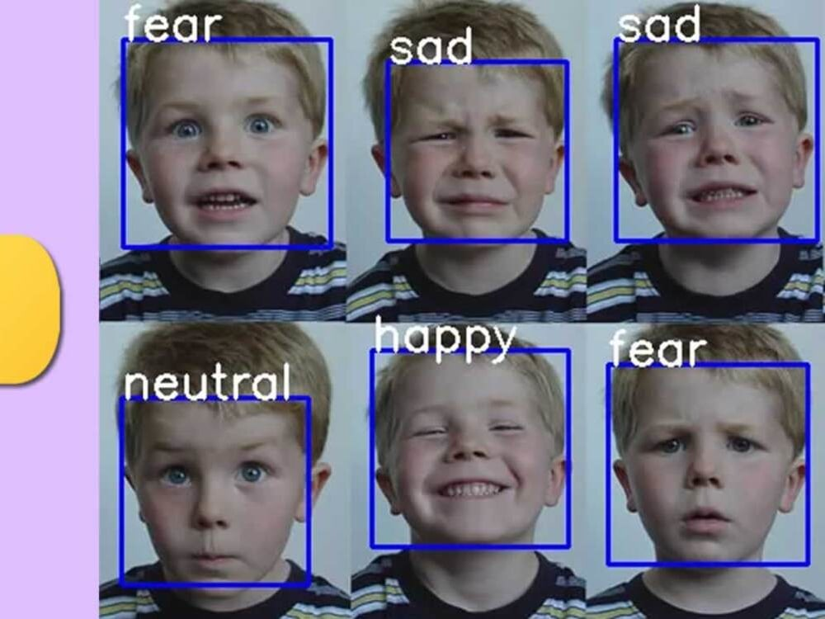
3.Human-Computer Interaction (HCI): Improves interaction by enabling emotional feedback.
4.Human Resource & Recruitment: Improves interview processes by reducing bias and subjectivity.
5.Security & Surveillance: Identifies suspicious or dangerous behaviors in public spaces.

Slide 7

ADVANTAGES:
Automates customer feedback analysis, improving business strategies.
Improves personalized experiences in applications like gaming, e-learning, and smart devices.
Works well in education, entertainment, healthcare, and security sectors.
By analyzing facial expressions, applications can adjust their responses to better suit the user's emotional state, creating more interactions.

Slide 8
LIMITATIONS
Accuracy Issues in Real-World Scenarios:
FER models may struggle with misclassifications due to variations in lighting, head poses, and facial occlusions (e.g., glasses, masks).
Lack of Context Awareness:
FER systems only analyze facial expressions but do not understand the context behind emotions.
Difficulty in Differentiating Emotions:
Some emotions like fear and surprise have similar facial expressions, causing classification errors.
High Computational Requirements:
Deep learning models require large datasets and high computational power for training.

Slide 9
PROBLEM STATEMENT
In today's digital world, understanding human emotions is crucial for improving human-computer interaction, mental health monitoring, security, and assistive technologies. However, traditional emotion recognition methods struggle with challenges such as variations in facial features, lighting conditions, occlusions (glasses, masks), cultural differences, and dataset biases, leading to inaccurate predictions. This project aims to develop a Convolutional Neural Network (CNN)-based Facial Emotion Recognition (FER) system that efficiently classifies emotions from facial images.

Slide 10

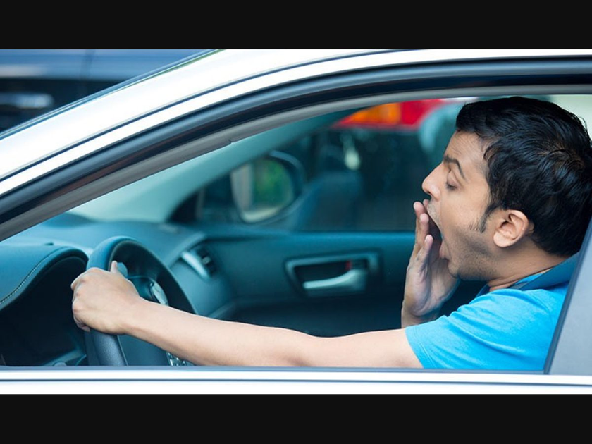
GAP IN STUDY
Assistive Technology for Blind People – Converts facial emotions into audio feedback.
Driver Alertness Monitoring – Detects drowsiness and provides real-time alerts.

Slide 11
Challenges:
Blind individuals cannot perceive facial expressions, limiting emotional understanding in conversations.
Solution:
For Blind People: This system translates facial emotions into sound cues, allowing them to hear emotions in real time.
Challenges:
Drowsy driving is a leading cause of road accidents, requiring an automated alert system.
Solution:
For Drivers: The system detects signs of drowsiness and issues alerts to prevent accidents.

Slide 12
METHODOLOGY
A) Assistive Technology for Blind People
Facial Emotion Detection:
Capture facial expressions using a webcam.
Classify emotions (Happy, Sad, Angry, Neutral, etc.).
Convert to Audio Feedback:
Once the emotion is detected, map each emotion to a distinct sound or spoken phrase.
Play the sound through a speaker for real-time emotion perception.

Slide 13
METHODOLOGY
B) Driver Alertness Monitoring
Face & Eye Detection:
Detect eye closure duration using OpenCV and deep learning.
Drowsiness Classification:
If eyes remain closed for a predefined period, detect sleepiness.
Alert System Activation:
Issue a beep alarm or voice alert to wake the driver.

Slide 14
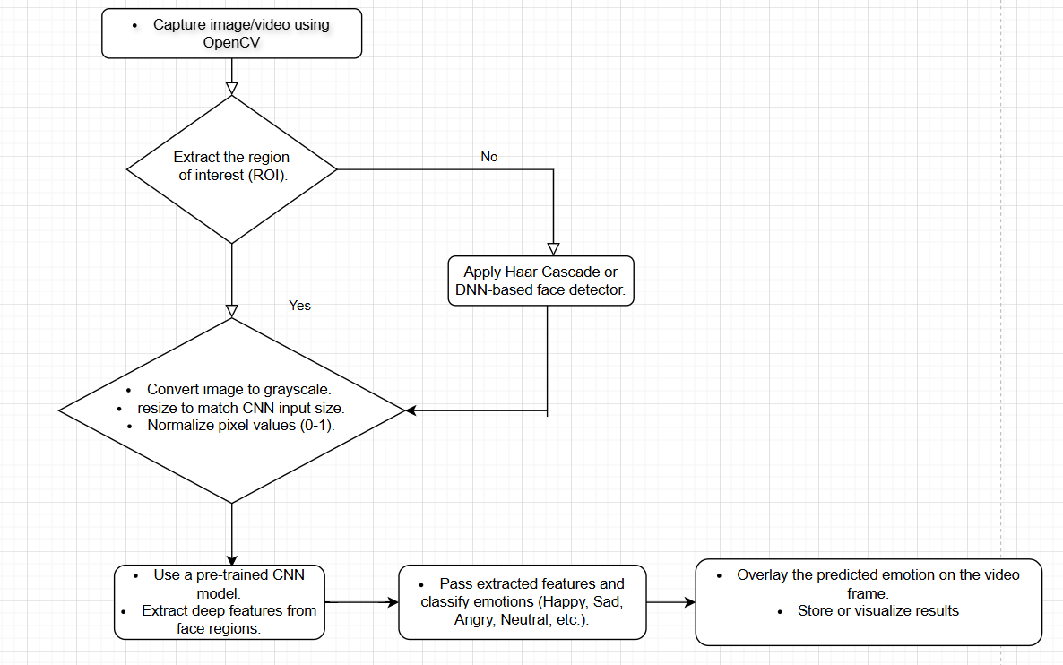

Slide 15
APPLICATIONS & BENEFITS
1. Assistive Technology for Blind People
Improves social interaction by providing emotional awareness.
Enhances accessibility and independent communication.
2. Driver Alertness Monitoring
Reduces road accidents caused by driver fatigue.
Increases road safety and driving efficiency.

Slide 16

DATA SET
For the facial expression recognition challenge, Kaggle is supplying training and testing photos (FER-2013). It's made up of grayscale photographs of people's faces that have been pre cropped to 48 pixels and labeled with seven different emotional states: neutral, surprise, sadness, happiness, fear, anger, and disgust. However, the training and testing purposes, the dataset contains 35887 facial photos with facial expression labels. These raw photos were transformed into training and testing images.

Slide 17
REFERENCE PAPERS
EMOTION RECOGNITION BASED ON CONVOLUTIONAL NEURAL NETWORK (CNN)-2021
HUMAN EMOTION DETECTION USING OPEN CV - 2022
ARTIFICIAL INTELLIGENCE AND FACE EMOTION PREDICTION BASED TRAINING FOR AUTISM KIDS -2022
EMOTION RECOGNITION IN IMAGES AND VIDEO WITH PYTHON FOR AUTISM ASSESSMENT-2024
REAL TIME EMOTION RECOGNITION USING IMAGE CLASSIFICATION - 2023
OPENCV AND PYTHON FOR EMOTION ANALYSIS OF FACE EXPRESSIONS-2023
AI AND FACE EMOTION PREDICTION BASED TRAINING FOR AUTISM KIDS-2020
MACHINE LEARNING AND DEEP LEARNING TECHNIQUES FOR EXPRESSION BASED FACIAL RECOGNITION-2023
IMPROVED OPTIMIZER WITH DL MODEL FOR EMOTION DETECTION-2024
EXPLORING DIFFERENT TECHNIQUES FOR EMOTION DETECTION THROUGH FACE RECOGNITION-2023

Slide 18
TIMELINE
First Review:
Define the problem statement and objectives and collection of Data set.
Conduct literature review and analyze existing emotion detection methods.
Select the methodology (CNN-based detection)
Second Review:
Implementation of code.
Training the model .
Test algorithm performance on sample datasets.
Final Review:
Implement real-time live FER system.
Solving error for better accuracy in real-world conditions.

Slide 19
THANK YOU!

